Slide 1
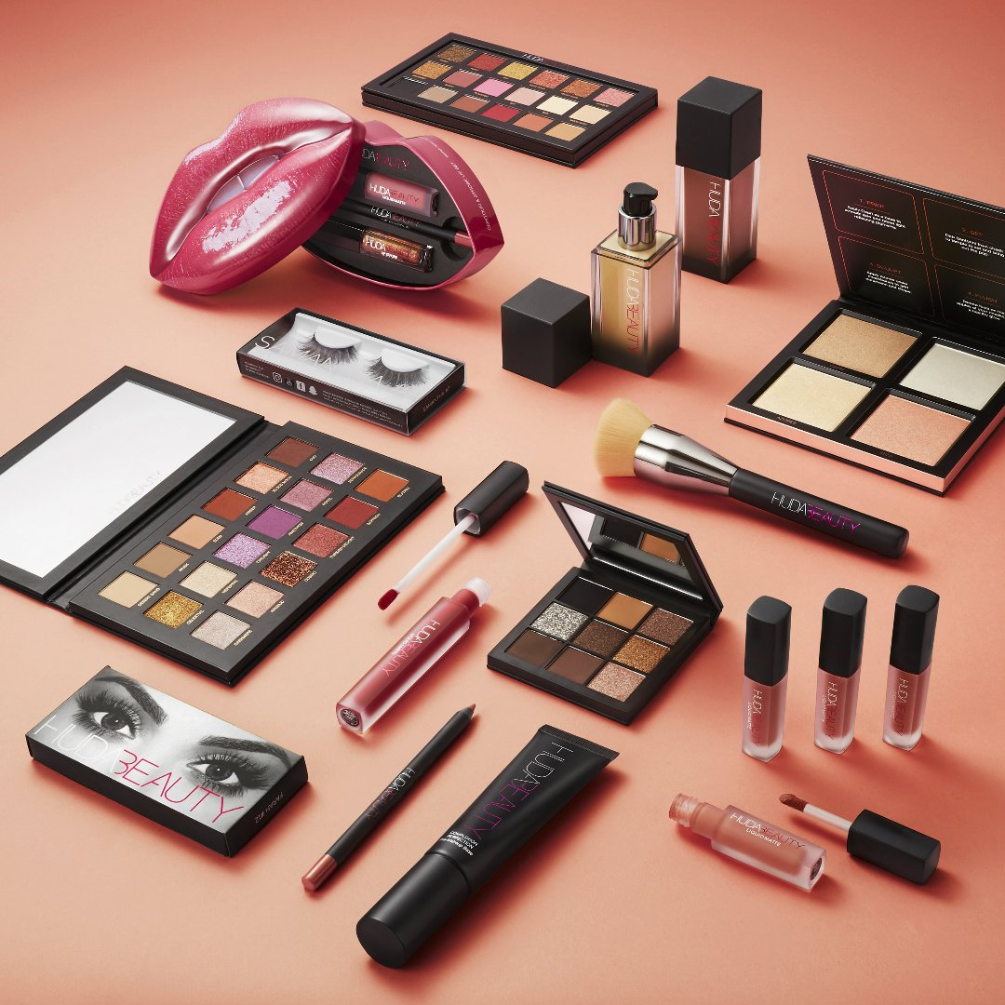
Huda kattan aka “huda beauty”
Nadia Chughtai
2/7/2025
MGMT302

Slide 2
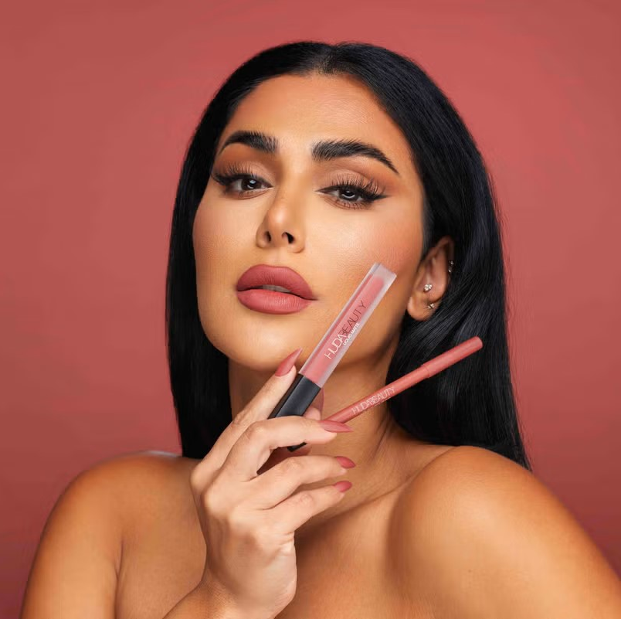
Who is Huda kattan?
Huda Kattan is an Iraqi-American makeup artist, beauty blogger/influencer, & entrepreneur
Famously known for creating her makeup brand “Huda Beauty” in 2013
Born in Oklahoma in 1983, grew up there & in Tennessee
Went to University of Michigan-Dearborn where she majored in Finance

Slide 3
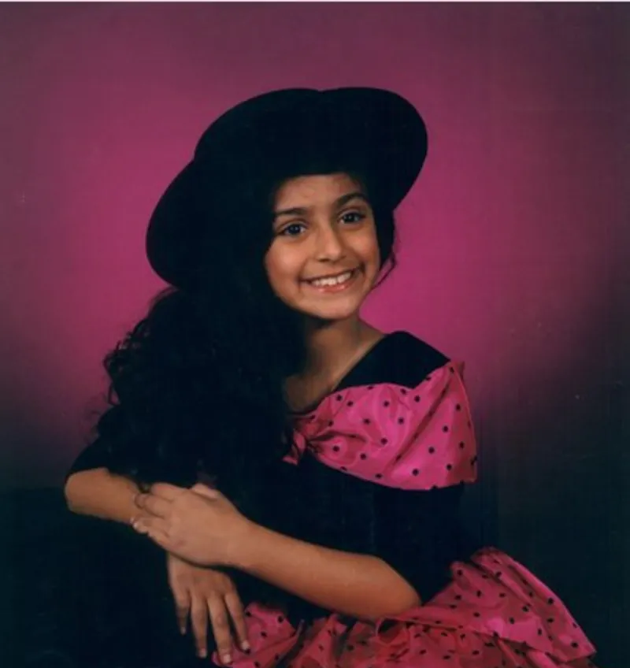
Childhood
Huda’s family had very little as she was growing up
Parents immigrated to the US from Iraq, struggled to take care of her & her 3 siblings
  living paycheck to paycheck, working past retirement age
“Truthfully, me and my family grew up super, super poor [in Oklahoma, then Tennessee]. My family was on welfare. My parents immigrated [from Iraq]. My dad was struggling just to make ends meet. It was harsh, sometimes really bad.” (Kattan for cnbc.com, 2019).
Huda loved makeup growing up but did not see it as a realistic career choice – at first

Slide 4

Motivation
Coming from a low-income immigrant family who struggled financially, Huda knew she had to make a change
She went to the University of Michigan-Dearborn & studied Finance, then got a job in recruiting.
However, she did not have much luck & was fired.
“I was working on weekends. I was in the office first, out of the office last. I was obsessed, and I got fired… honestly, getting fired was the best thing that happened to me.” (Kattan, 2019).
In 2010, she started a makeup blog called “Huda Beauty.” Thus was the start of her iconic brand.
Posted tutorials, tips, product recommendations

Slide 5
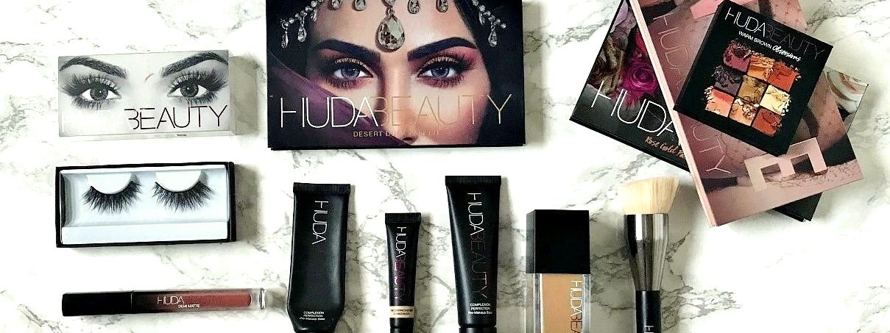
From blogging to product creation
In 2006, she moved to Dubai with her father. A few years later, Kattan moved to LA, where she studied makeup
She returned to Dubai where she got a job as a makeup artist. Some of her clients were A-list celebrities Eva Longoria and Nicole Richie!
For 3 years, she posted on her blog and gained more and more followers, grew her social media (esp. Instagram and YouTube)
In 2013, she decided to launch a line of false eyelashes, and surprisingly made a deal with Sephora to sell them in their stores!
  This expanded her brand awareness immensely, even Kim K started wearing her lashes

Slide 6
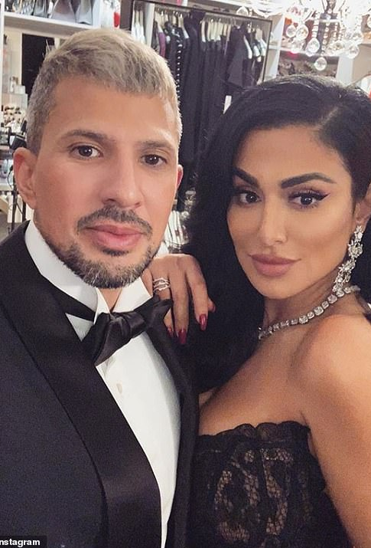
Branching out
Upon the success of her lashes & social media following blowing up, Huda decided to branch out and start creating makeup products like foundation, lipsticks, concealers, eyeshadows, etc.
  Her lashes already being sold in Sephora made this addition easier
However, she faced sexism & community pushback
Many brands would not take her seriously, despite her success in Sephora and celebrity makeup artist status. As she spoke out social issues, people attacked her online. She is a proud Muslim & suffered from Islamophobia
She stated in 2023, “The beauty industry is sexist… Oftentimes we'd be in a meeting and instead of making eye contact with me they would make eye contact with my husband and completely ignore me. “Don't talk to me, talk to her," her husband would say - but they would just continue addressing him.” (Kattan, 2023. BBC.com).

Slide 7
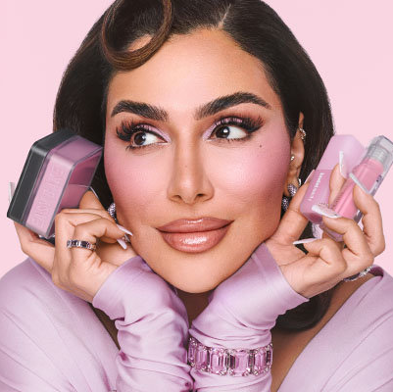
Success, Activism, charity
Huda Kattan’s net worth is estimated to be around $560 million as of 2023. She is:
  #15 in Forbes’ Top Creators (2023)
  #66 in Forbes’ America's Self-Made Women (2023)
Her success prompted her to give back to charities & organizations such as the NAACP’s Legal Defense & Education fund ($500K), $1M to Doctors Without Borders & Gaza, and many more!
Huda Beauty became a massive success in the beauty world. The company has:
  54.7 million followers on Instagram
  Almost $1 billion net worth
  100s of products and collabs/brand deals and a clear mission to be cruelty-free

Slide 8
What I take away from Huda
Huda Kattan’s story is extremely inspiring. She is a child of immigrants who came to America with very little, to give her a better life. She took that opportunity & turned it into a billion-dollar company!
She is also a Muslim woman crushing the entrepreneurship world, which is not something you see everyday. For me, as a Muslim women in business & wanting to go into entrepreneurship, it’s a breath of fresh air seeing someone like myself becoming this successful & mainstream
She took her parents mindset of working hard & never giving up, even in the face of being fired, facing financial hardships, struggling to get by, & dealing with sexism & racism, and created the insanely successful empire she has today
We can all learn from her, to not give up in the face of hardships & rejections, & to keep trying even when life knocks us down. It instills in us to keep working at our hopes & dreams because one day we could get our big break in the business world

Slide 9
sources
Huda Kattan – Forbes
Huda Kattan turned her passion into a billion-dollar business
Glamorous beauty blogger shares 'pre-nose job' photo | Daily Mail Online
https://richardmagazine.com/huda-beauty-lip-tins/
https://www.bbc.com/news/world-67385873
https://www.beautylymin.com/2018/11/the-huda-beauty-products-worth-hype.html

